Slide 1

Top Food Truck Locations
NYC
Savan Desai, Karen Ouyang, Ferdinand Wohlenberg
Notes:
Hi everyone, we are Karen, Savan and me (Ferdinand) and we’ll be presenting to you the Top Food Truck Locations in NYC with a focus on Manhattan.

Slide 2
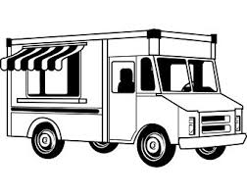
Food Truck Facts
5,100 mobile-food-vending permits (trucks + carts)
500 belong to food-truck operators
Most common food: Ice cream
Where should you put your food truck in Manhattan and what type of cuisine should you consider making?
Notes:
There are over 5000 mobile food vending permits around New York City with about 500 belonging to Food truck operators. As the owner of a food truck company, the question often arises where to best place the foodtruck and what type of cuisine should you consider making? Therefore we thought looking at train stations traffic might be a good indicator of foot traffic and as to where the best location for a certain food truck shall be.
https://www.nycfoodpolicy.org/new-york-city-food-numbers-food-trucks/

Slide 3
Methodology
MTA Turnstile Data
Data Wrangling
Recommendations
April 6, 2019 - July 6, 2019
(14 weeks)
Source: MTA Turnstile Data
(http://web.mta.info/developers/turnstile.html)
Cleaning
Aggregation
Tools: Pandas, Numpy, Seaborn, Pickling,etc.
APIs (Yelp, GoogleMap)
Top 3 stations
Nearby popular cuisines
Notes:
We started our data analysis by downloading 14 weeks of MTA Turnstile Data from the official MTA website.
The data is ranging from April to beginning of July 2019.
Had to engage in Data Wrangling first before we could start with our exploratory analysis
Cleaning Datasets (from inconsistent or falsified entries), Clustering(‘breakfast, weekdays)
We did so by using tools such as Pandas, Numpy, Seaborn, etc.
Made use of Yelp and Google API to pin down stations and find restaurants near that station
In the end, top 3 stations and nearby popular cuisines

Slide 4
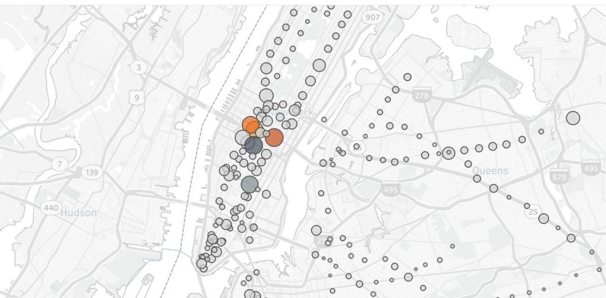
Foot Traffic Map - Train Stations
Notes:
April to beginning of July 2019. (14 week)
Each Circle represents total entries per station
Stations with highest traffics are in Midtown Manhattan.

Slide 5
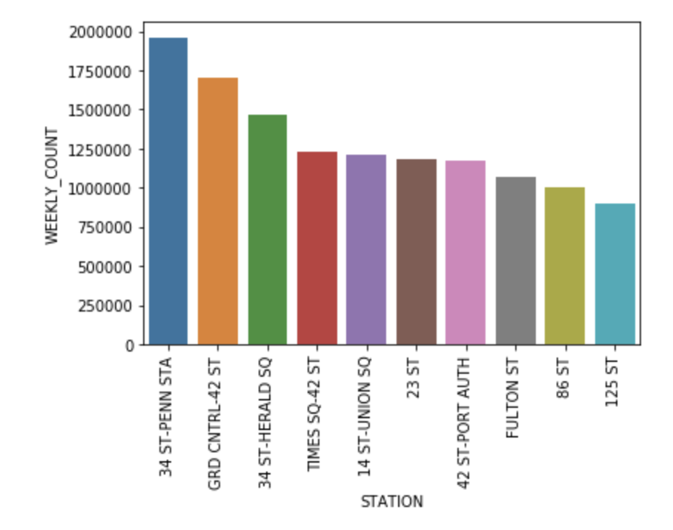
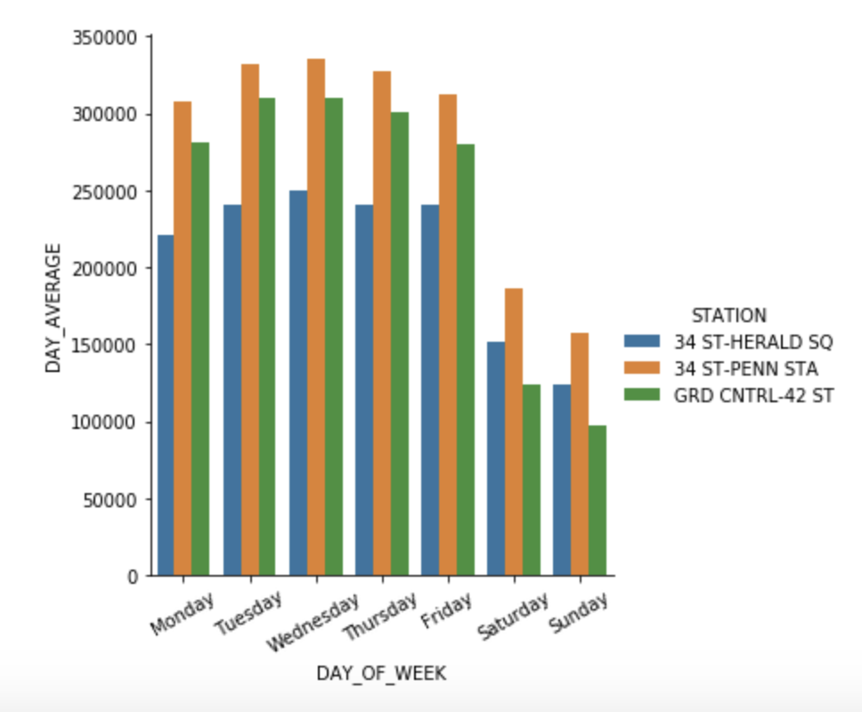
Insights
Top 10 Stations - Weekly Count
Daily Average Count
Notes:
Top 10 stations with highest foot traffic per week
Weekdays : weekend

Slide 6
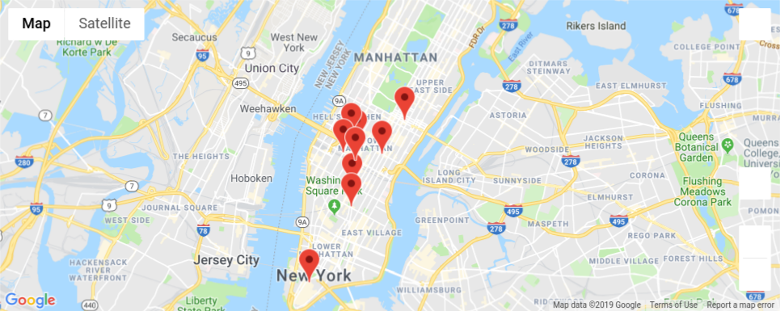
Top 10 Stations Recommendation
Notes:
ST-PENN STA
GRD CNTRL-42 ST
34 ST-HERALD SQ
TIMES SQ-42 ST
23 ST
42 ST-PORT AUTH
14 ST-UNION SQ
FULTON ST
86 ST
125 ST

Slide 7
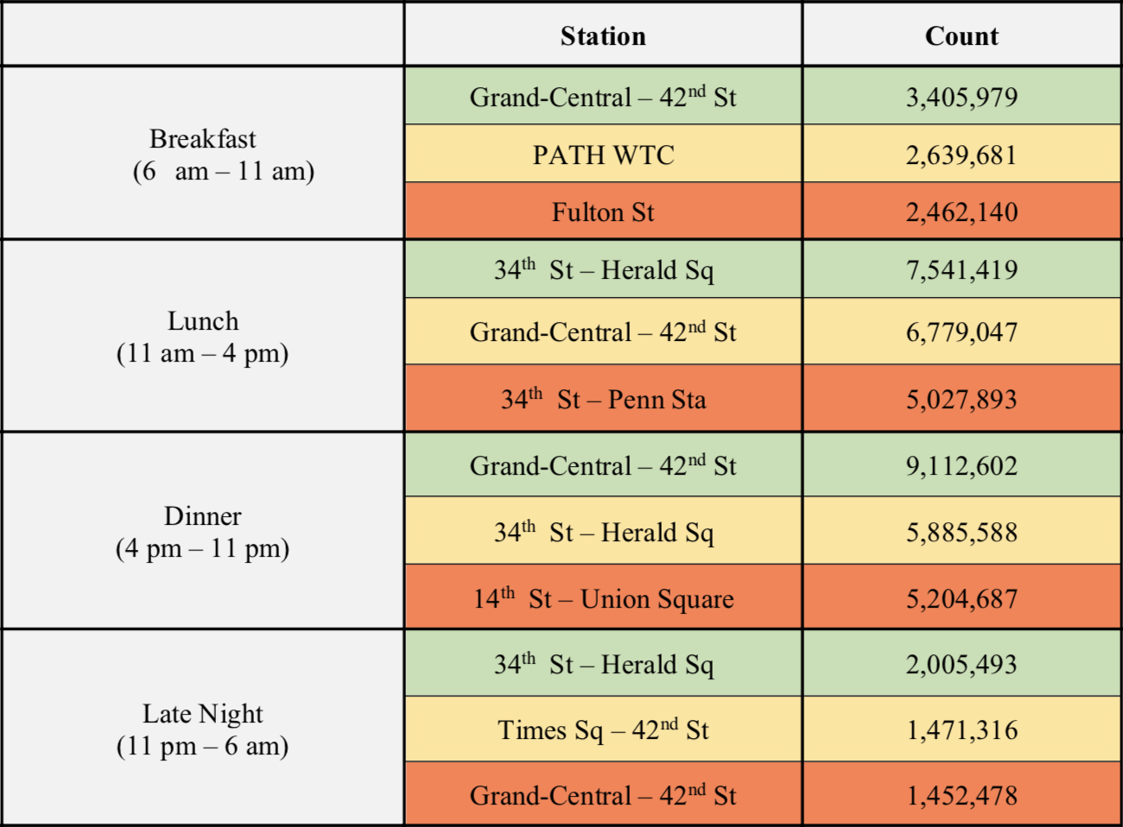
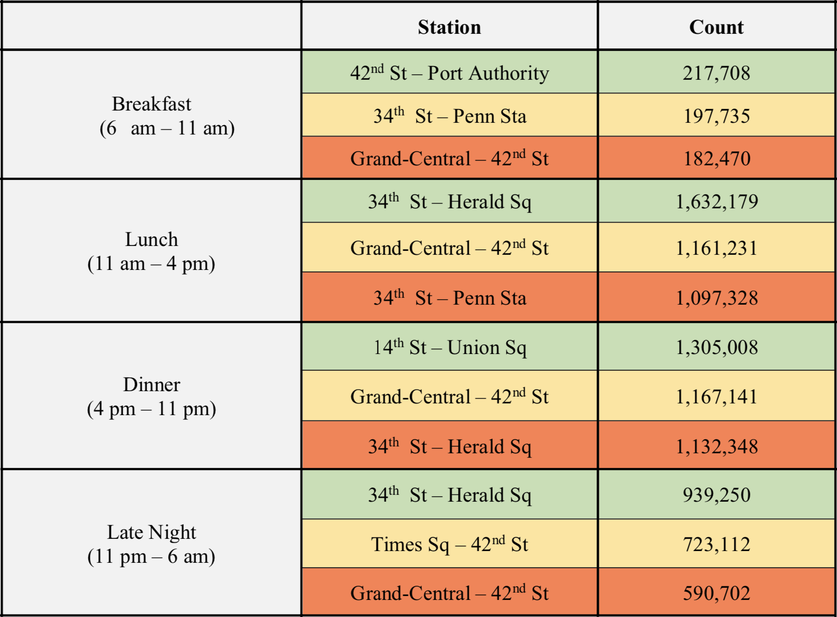
Recommendations
Traffic Workweek
Traffic Weekend
Notes:
We divided up time into four groups- breakfast, lunch, dinner, and late night and we divided up the week into the workweek and the weekend. Then, we summed up the foot traffic in those groups over 14 weeks and found the top 3 stations with the most foot traffic. Grand Central -42nd Street appears in all of the groups and 34th St. Herald Square, 34th St. Penn Station, and 14th St. Union Square are also very popular stations.

Slide 8
Popular Cuisines Near Popular Stations
Japanese
Italian
New American
Grand-Central - 42nd Street
Italian
New American
Korean
34th St- Herald Square/Penn Station
New American
Japanese
Seafood
14 St- Union Square
Notes:
Using the Yelp API, we were able to search for restaurants given a zipcode. The Yelp API always returns the top 20 restaurants near the zipcode. We sorted the top 20 restaurants by cuisine and found the top 3 cuisines that appeared most often in our search. As you can see, New American shows up in the top 3 cuisines in our popular stations. Japanese and Italian also are popular choices of food. This information can give insight to our food truck company when they decide what type of cuisine they want to make for their food truck. For example, if New American and Japanese is a popular in all of the stations, perhaps making a food truck that sells a fusion of New American and Japanese food might be a good idea.

Slide 9



Main Takeaways
High amount of foot traffic in Midtown
Top Stations:
Grand Central - 42nd Street
34th St - Herald Sq / Penn Station
14 St - Union Square
Japanese, New American and Italian as most popular cuisine
Notes:
Using the Yelp API, we were able to search for restaurants given a zipcode. The Yelp API always returns the top 20 restaurants near the zipcode. We sorted the top 20 restaurants by cuisine and found the top 3 cuisines that appeared most often in our search. As you can see, New American shows up in the top 3 cuisines in our popular stations. Japanese and Italian also are popular choices of food. This information can give insight to our food truck company when they decide what type of cuisine they want to make for their food truck. For example, if New American and Japanese is a popular in all of the stations, perhaps making a food truck that sells a fusion of New American and Japanese food might be a good idea.

Slide 10


Slide 11
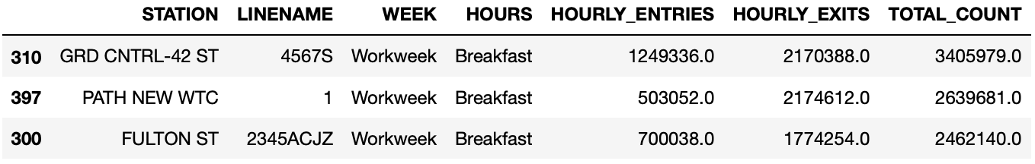
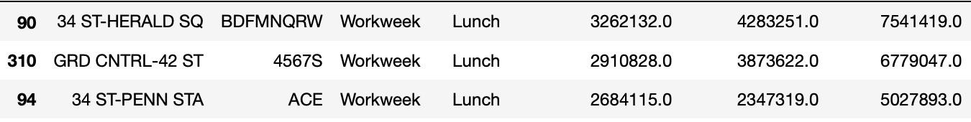
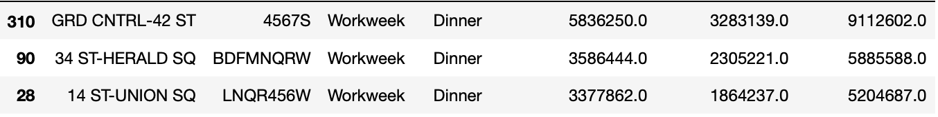
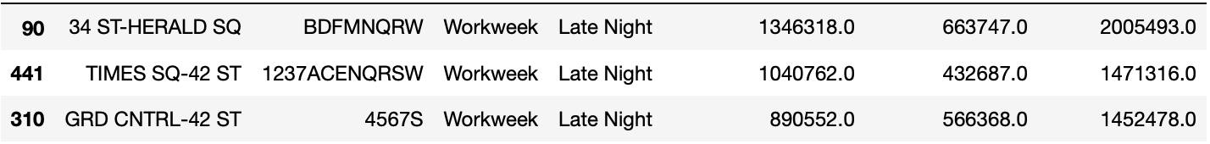
Appendix

Slide 12
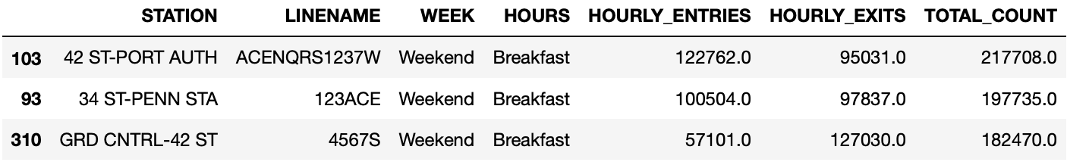
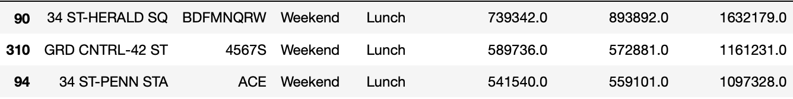
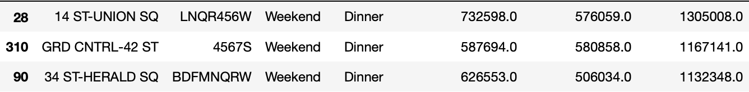

Appendix

Slide 13
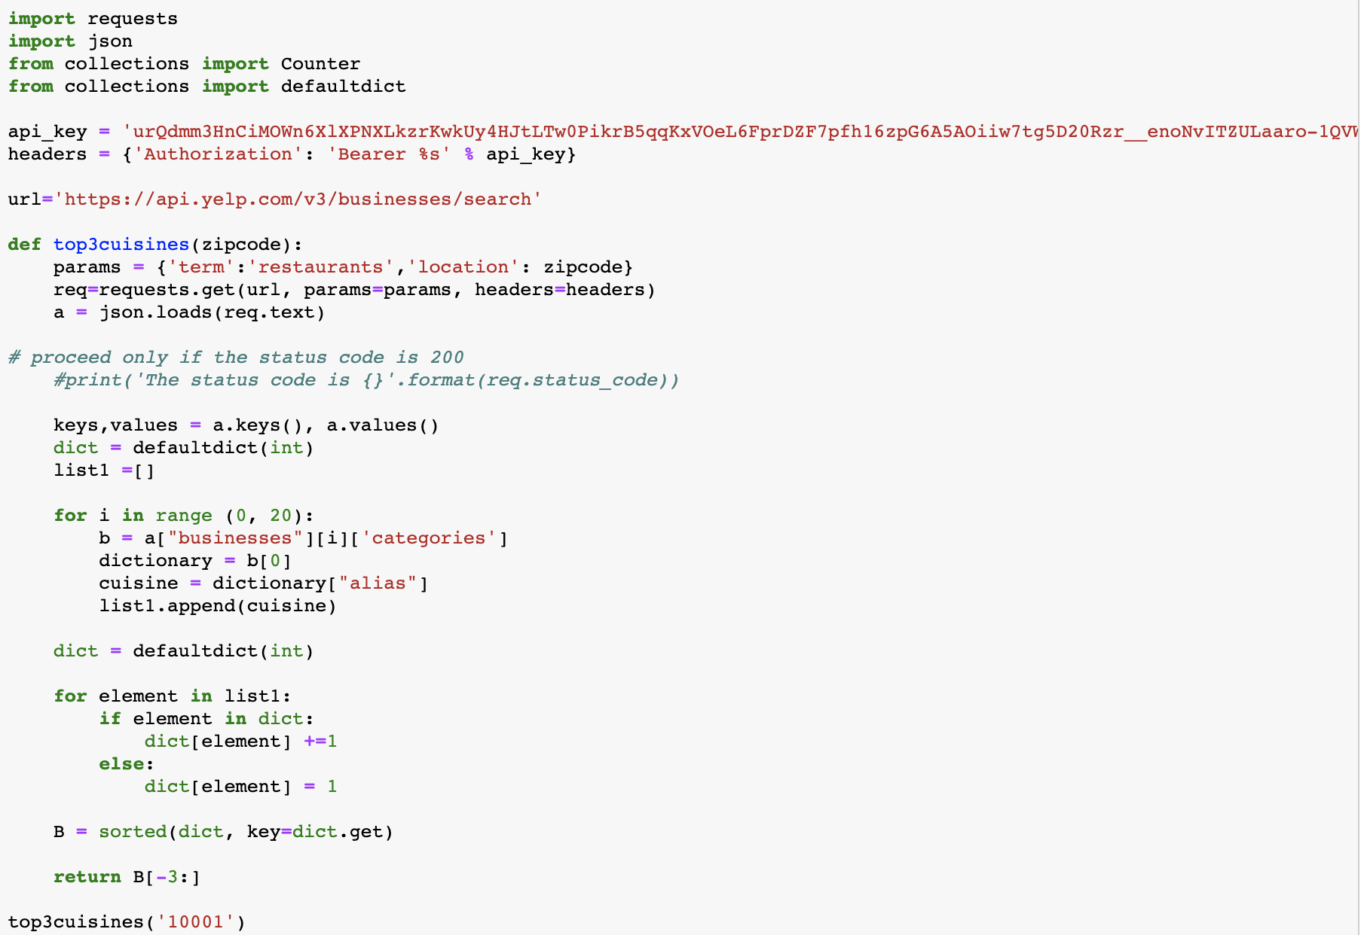
Appendix

